Slide 1

Voltage Dividers
Pete Januarius – June 2019

Slide 2
Goals
Success Criteria
Understand what a voltage divider is
Discover applications of a voltage divider
Build a voltage divider on a simulator
Build a voltage divider on a breadboard
Explain what a voltage divider is used for
Understand how a voltage divider circuit works

Slide 3
What is a Voltage Divider?
A voltage divider is a simple circuit which turns a large voltage into a smaller one.
Using just two series resistors and an input voltage, we can create an output voltage that is a fraction of the input.
Voltage dividers appear everywhere in electronics and are important to know about.

Slide 4
But first.....
Let’s remind ourselves why we need and use resistors again.. and look at OHM’s LAW

Slide 5
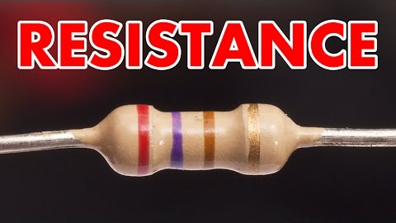
Watch... Resistance & OHM’s Law
https://youtu.be/NfcgA1axPLo

Slide 6
Voltage Dividers – The Circuit
A Voltage divider involves applying a voltage (V_{in}) across 2 or more resistors (R₁ & R₂) in series (end-to-end).
V_{out} is the voltage ‘drop’ across the resistor R₂. Vout is essentially the value that we are trying to work out
Using different value resistors, we can vary the value of Vout. We know that the total voltage drop across both resistors is equal to V_{in}

Slide 7
Voltage Dividers – The Circuit (again)
A Voltage divider involves applying a voltage (V_{s}) across 2 or more resistors (R₁ & R₂) in series (end-to-end).
V_{out} is the voltage ‘drop’ across the resistor R₂. Vout is essentially the value that we are trying to work out
Using different value resistors, we can vary the value of Vout. We know that the total voltage drop across both resistors is equal to V_{in}
NOTE: V_{in} and V_{s} are two ways of saying exactly the same thing!

Slide 8
Voltage Dividers – The Equation
Resistor 2
Voltage Out
Resistor 1
Voltage In
If you know the values of the input voltage and both resistors, you should be able to find out the output voltage!

Slide 9
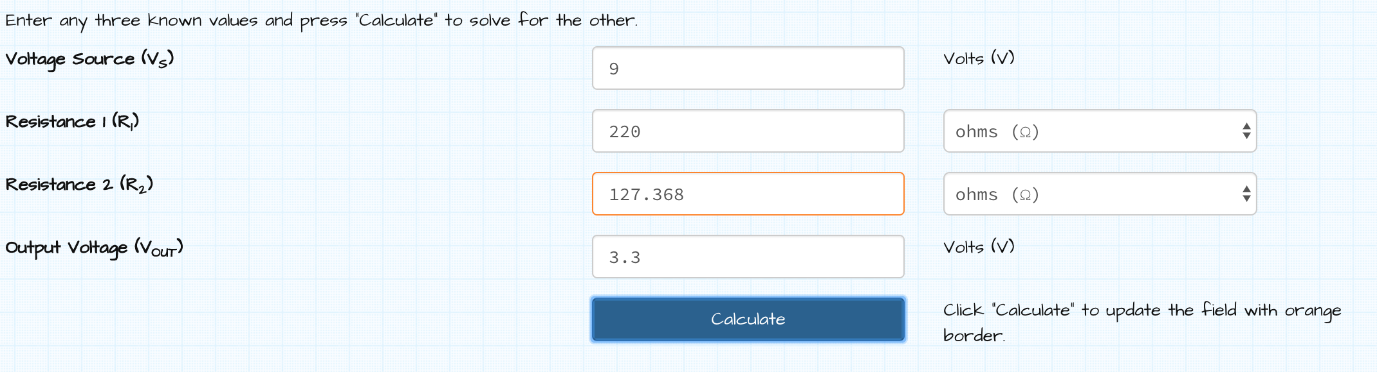
Voltage Calculator (activity)
Goto: http://www.ohmslawcalculator.com/voltage-divider-calculator
Imagine you are using a Voltage (input) source of 9v – that is a 9 volt battery and you want to output either 5v or 3.3v. What combinations of resistors could you have?

Slide 10
Equation Simplifications 1
(for those who like math)
If R₂ and R₁ are equal, then the output voltage is half that of the input.
This is true regardless of the resistors’ values

Slide 11
Equation Simplifications 2
(for those who like math)
If R₂ is much larger than R₁ then the output voltage will be very close to the input. There will be very little voltage acoss R₁

Slide 12
Equation Simplifications 3
(for those who like math)
If R₂ is much smaller than R₁ the output voltage will be tiny compared to the input. Most of the input voltage will be across R₁

Slide 13
Applications of Voltage Dividers
Potentiometers
A potentiometer is a variable resistor which can be used to create and adjustable voltage divider. You see them every day!

Slide 14
How Potentiometers work
The ‘wiper’ divides the resistor into two, therefore changing V_{out}

Slide 15
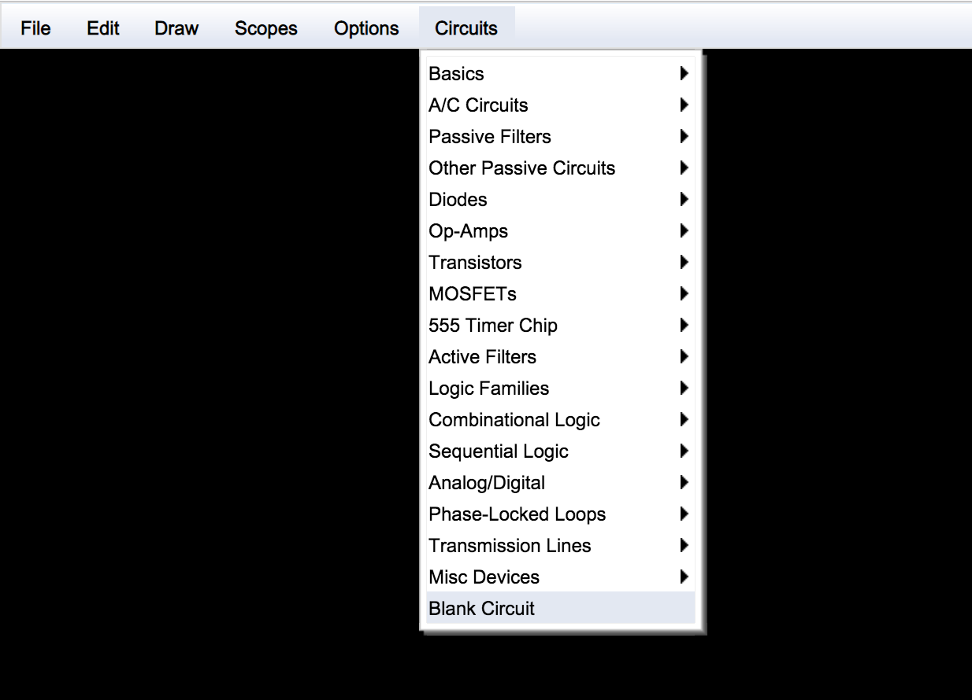
Activity: Build a Voltage Divider
Project 1: Using a Simulator
Goto: http://lushprojects.com/circuitjs/circuitjs.html
Choose ‘Blank Circuit’

Slide 16
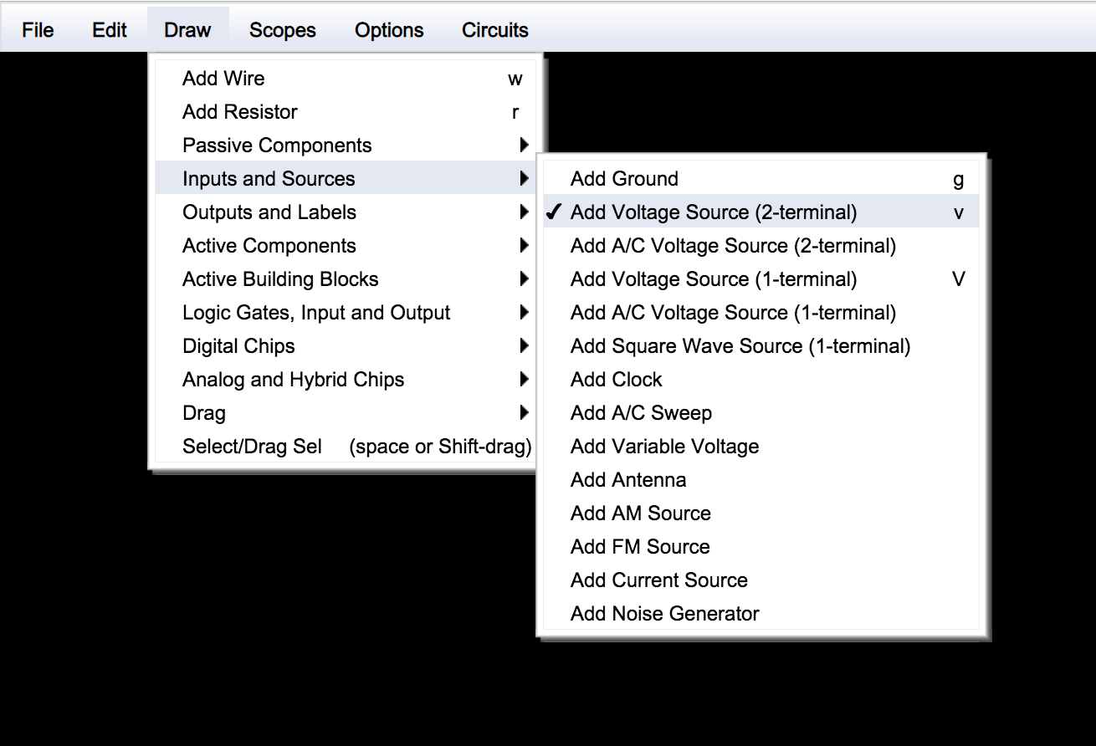
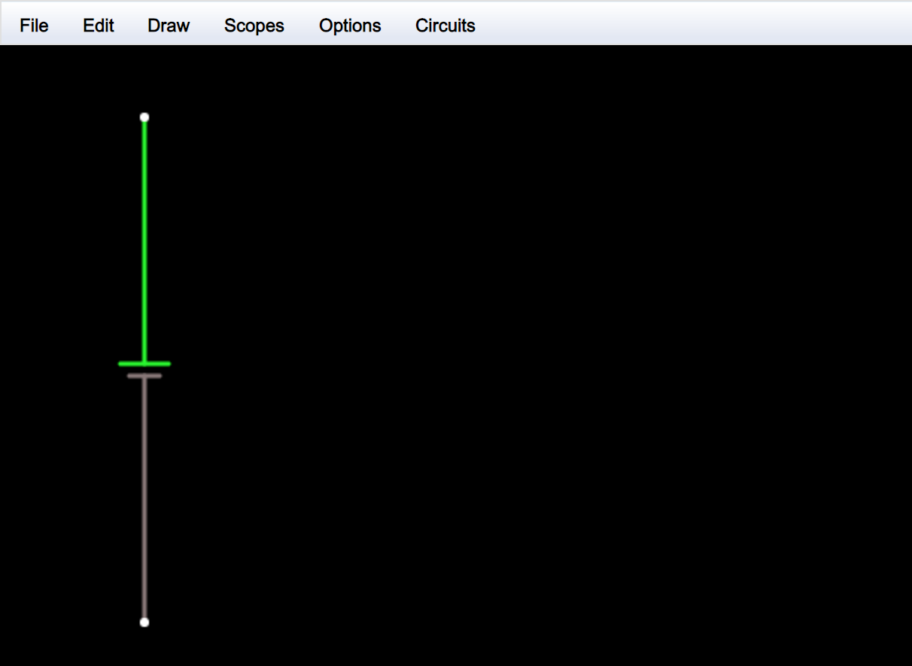
Activity: Build a Voltage Divider
Add the voltage source (battery) and draw it on.

Slide 17
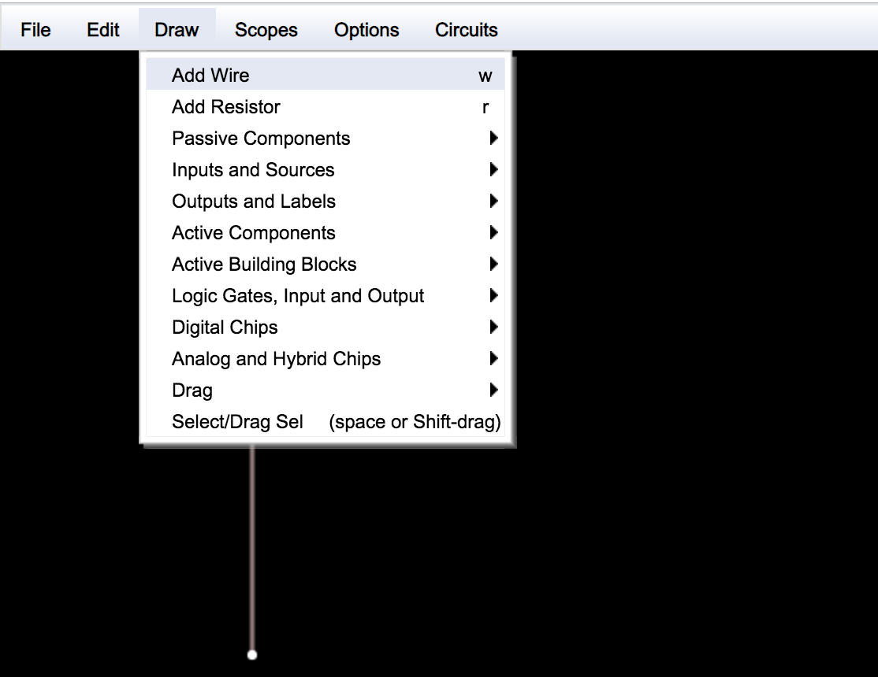
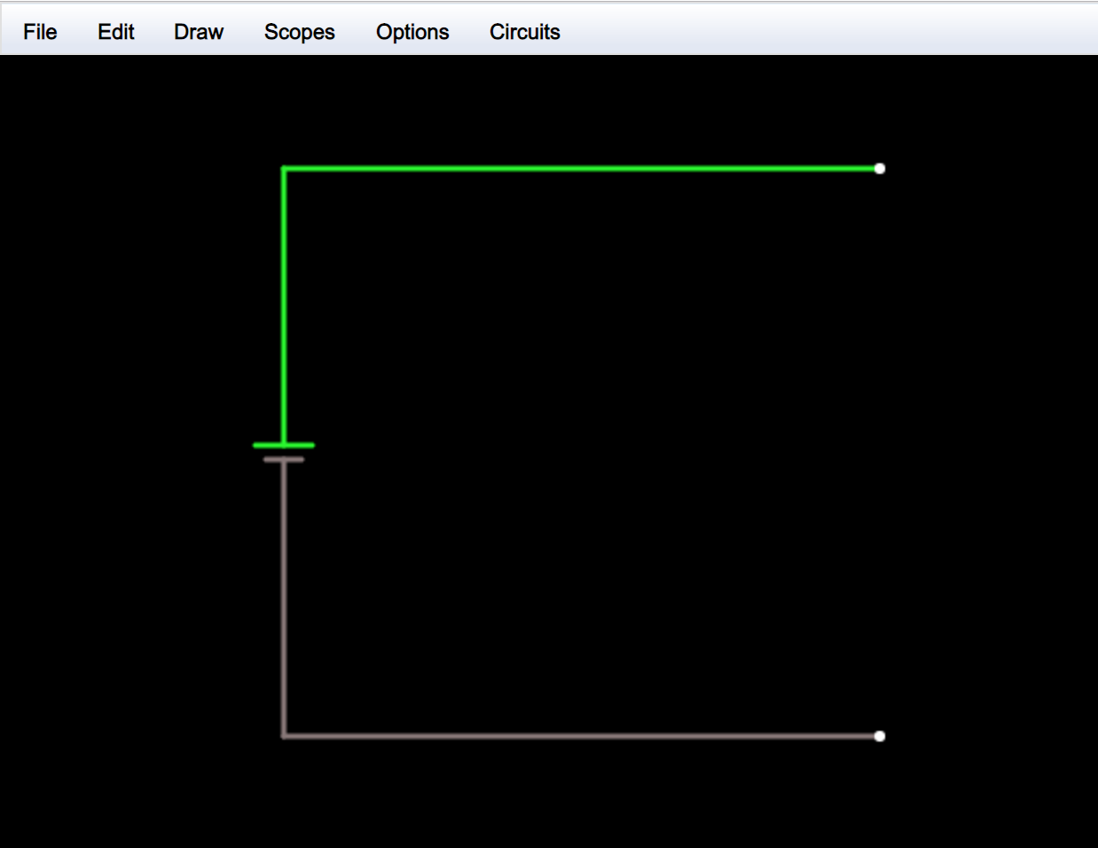
Activity: Build a Voltage Divider
Add connector wires to battery

Slide 18
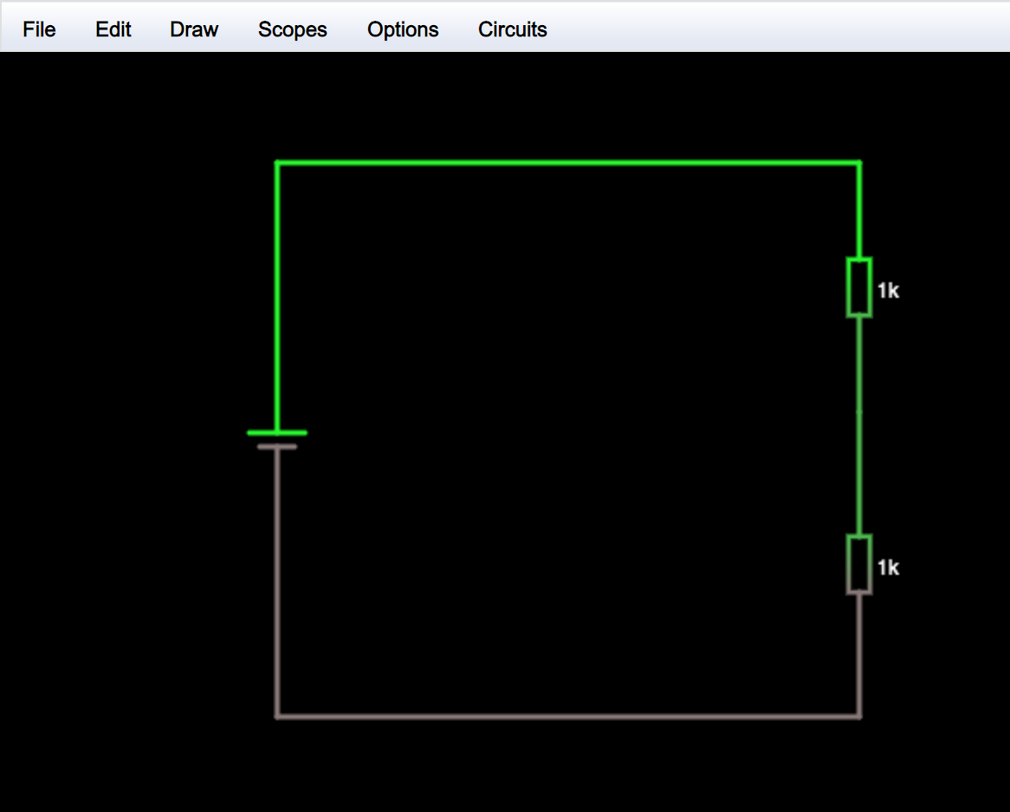
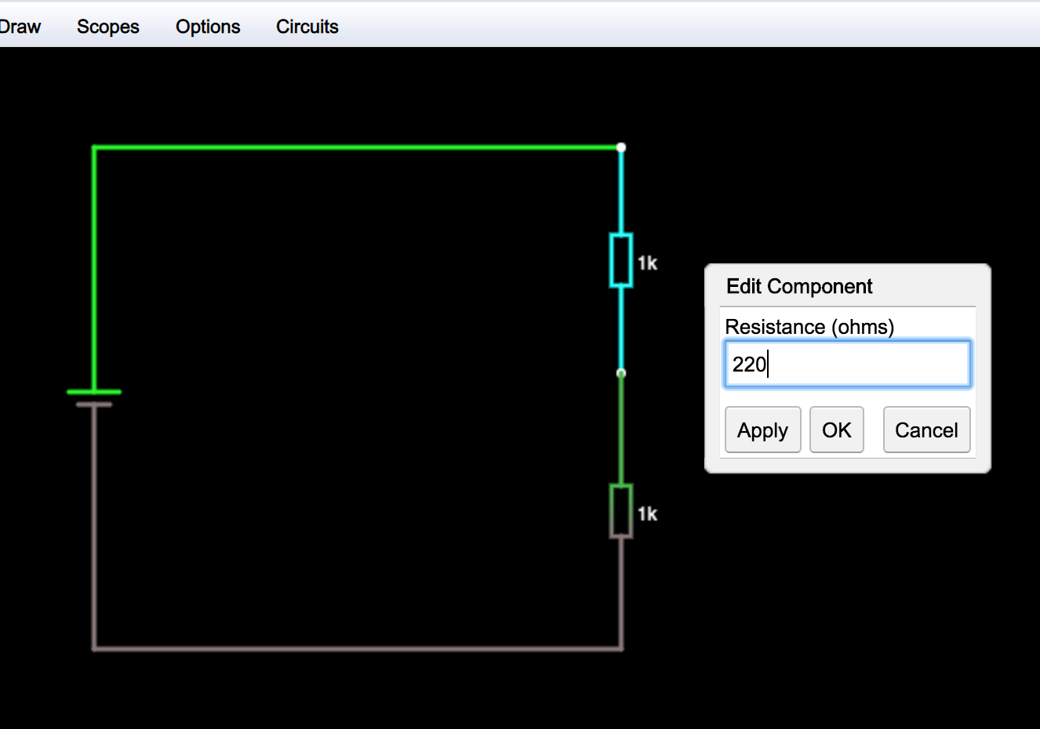
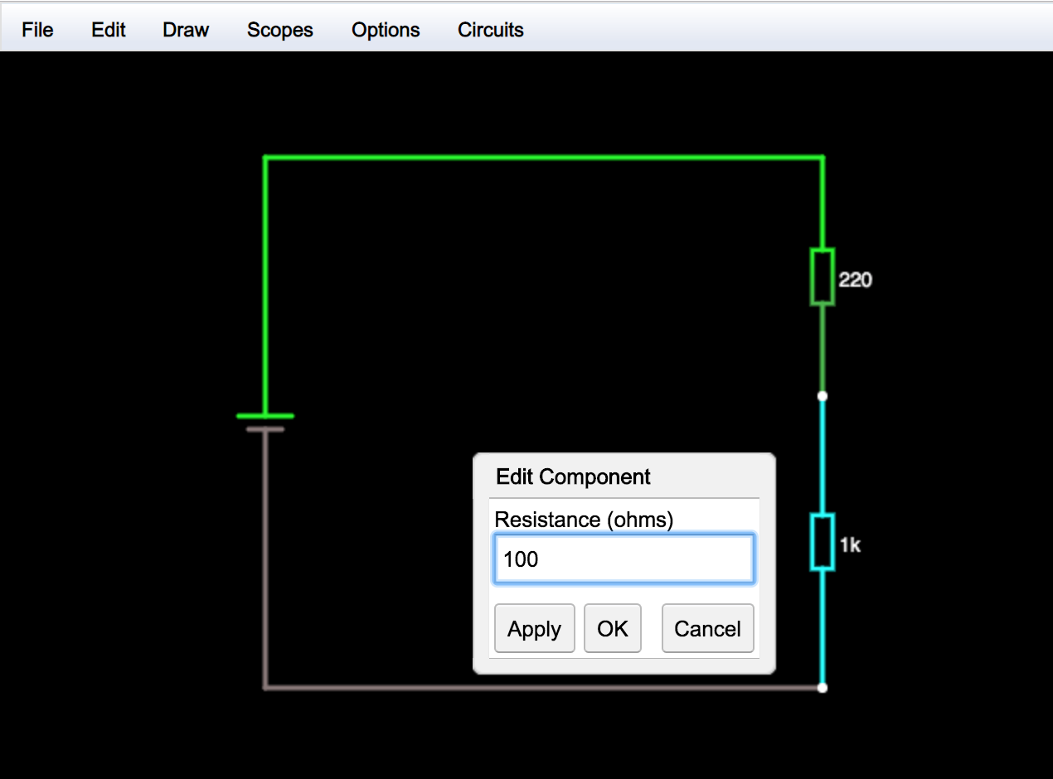
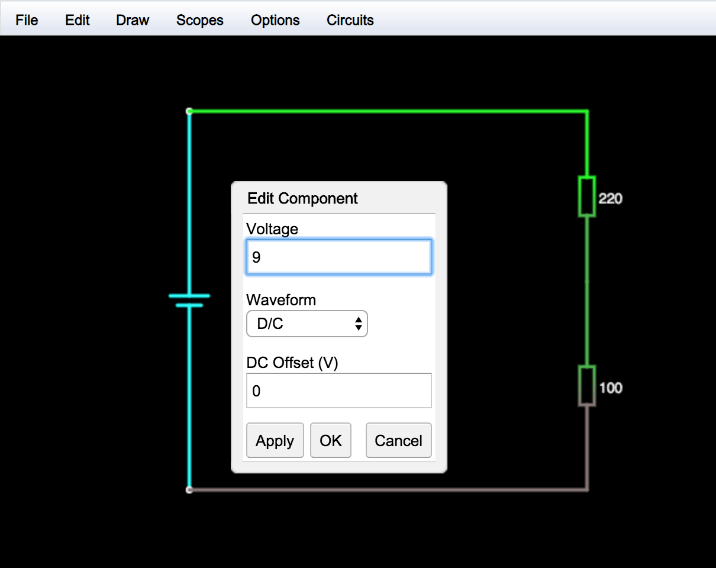
Activity: Build a Voltage Divider
Add some numbers

Slide 19
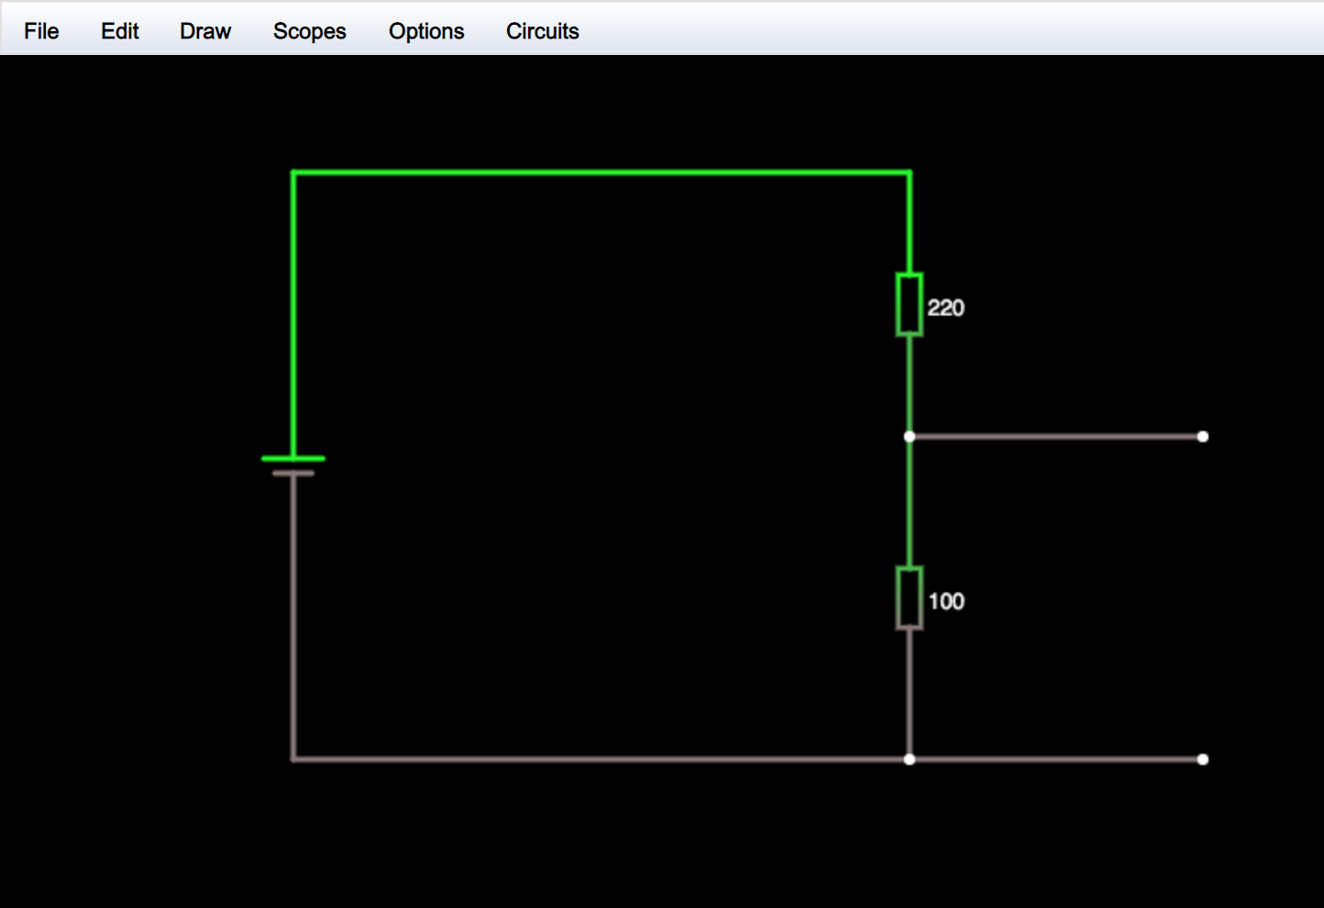
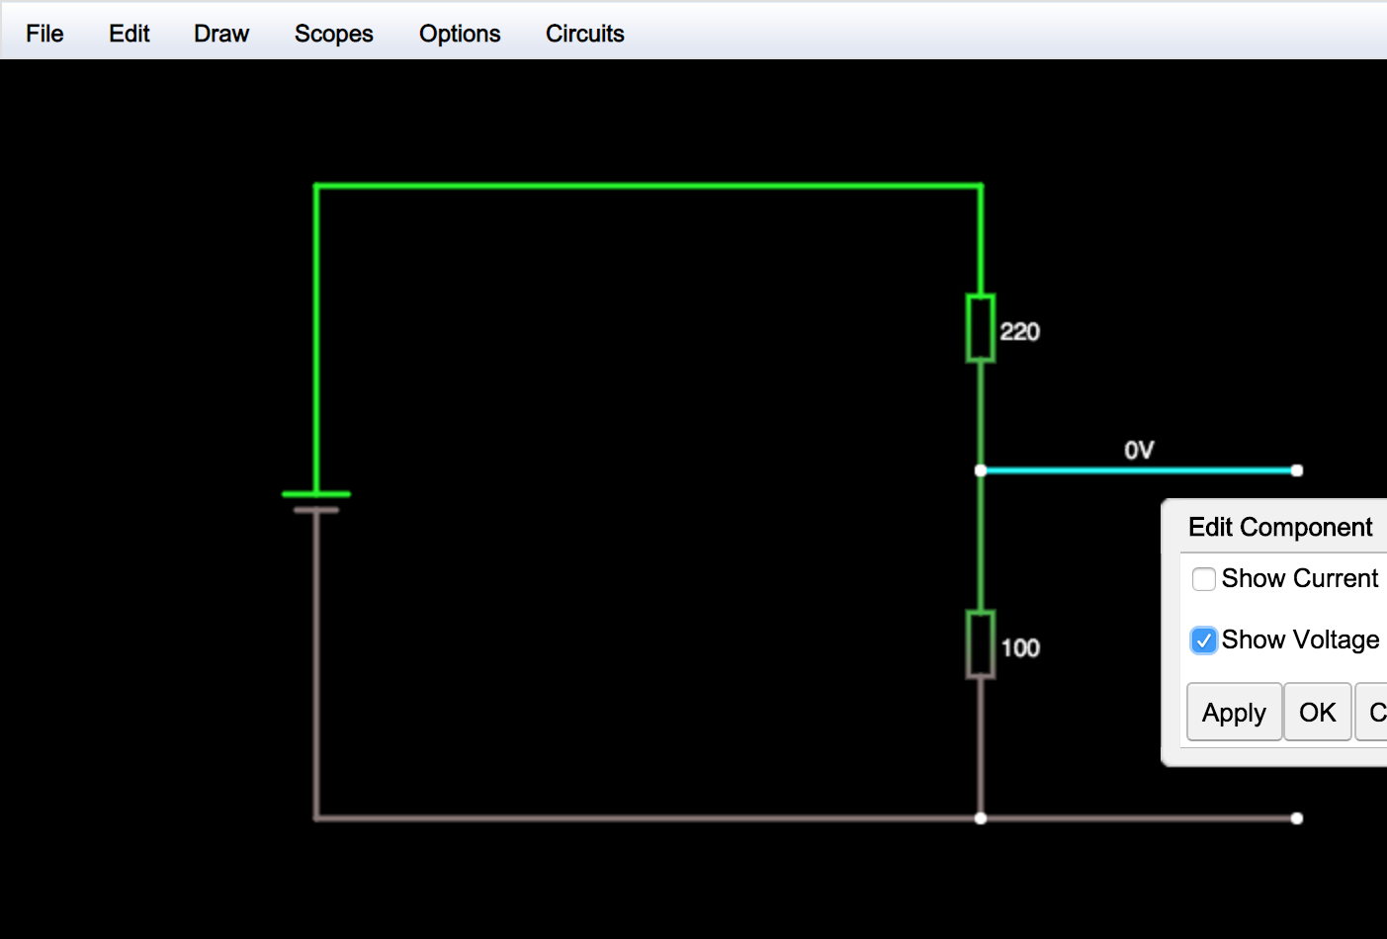
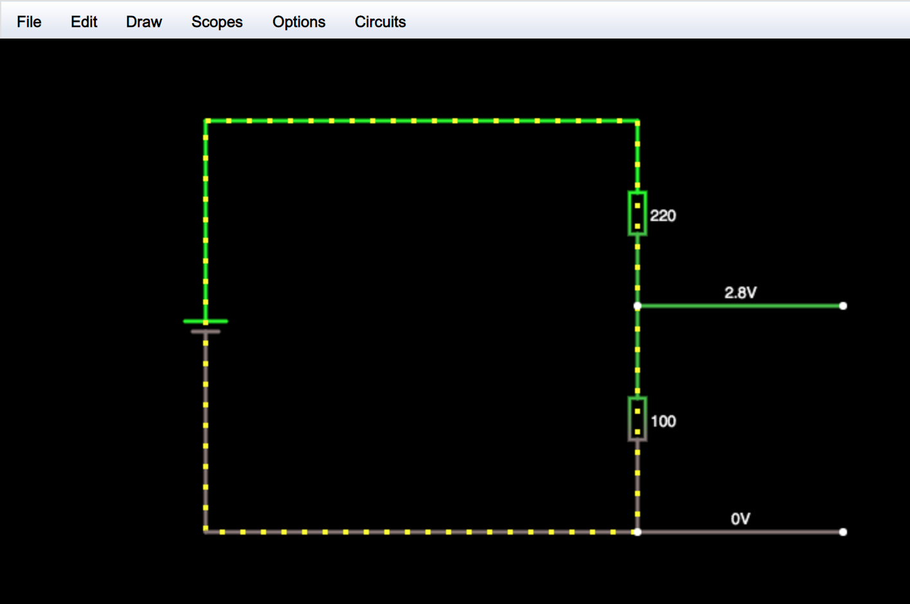
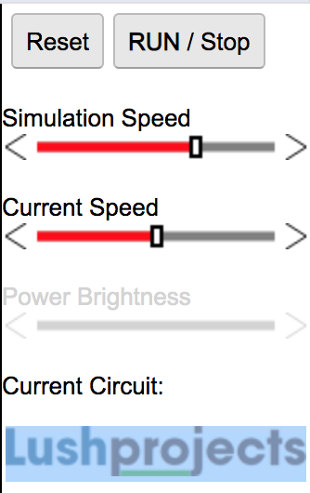
Activity: Build a Voltage Divider
Run the simulation

Slide 20
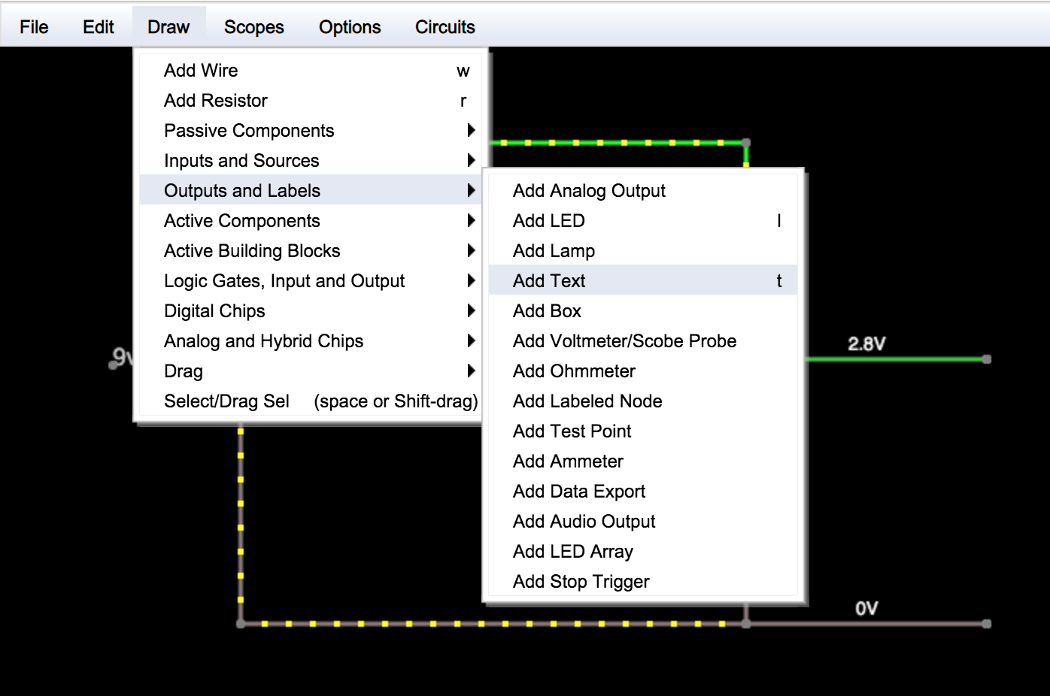
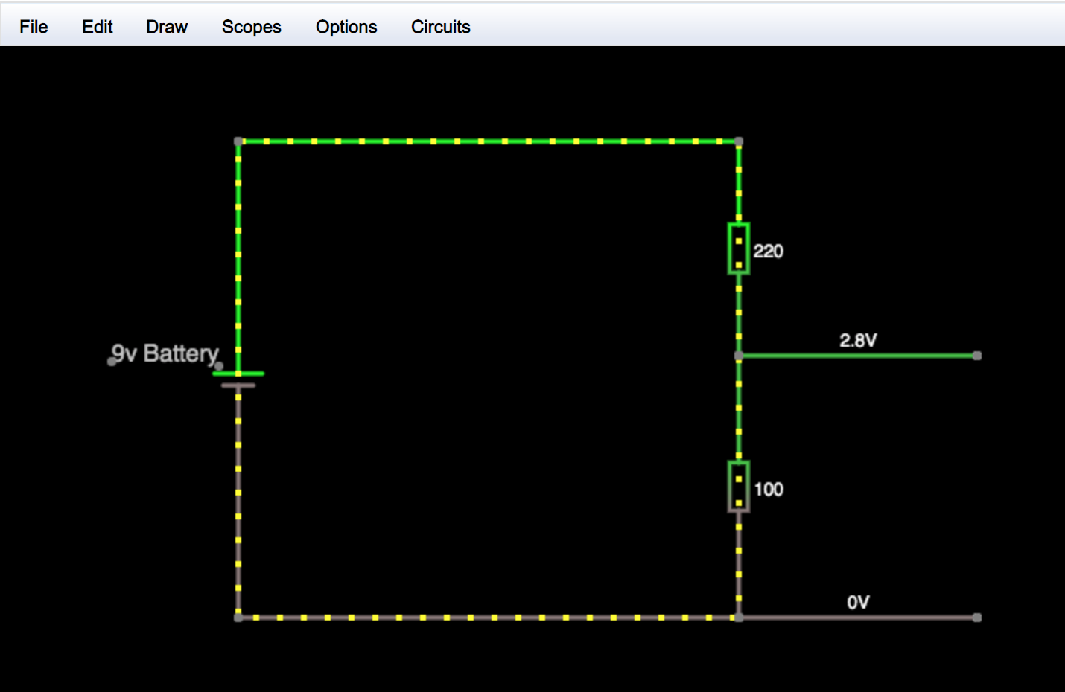
Activity: Build a Voltage Divider
Add labels for voltages

Slide 21
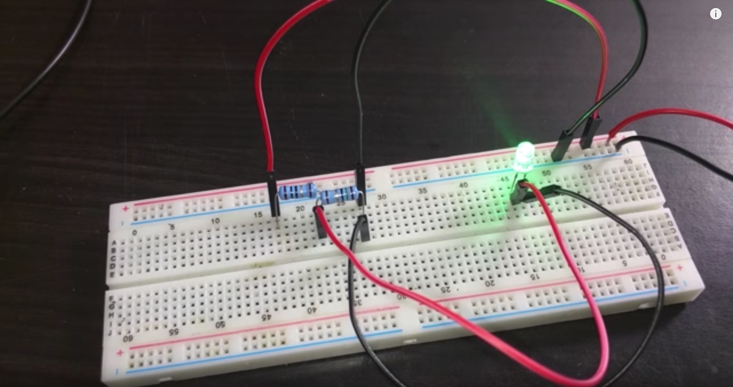
Activity: Build a Voltage Divider
Project 2: Using a Breadboard
https://youtu.be/L321aqTvrLQ

Slide 22
Homework
Watch: Reading DC Voltage with Arduino - https://youtu.be/TbLdAQpE4jE
The project on the left is purely there to inspire you! it is not what you will be building – although you certainly could if you wanted to!
Potentiometer

Slide 23


